Slide 1
Lecture 1: Introduction to deep learning
Practical deep learning

Slide 2
About this course
Introduction to deep learning
basics of ML assumed
mostly high-school math
much of theory, many details skipped
1st day: lectures + small-scale exercises using Jupyter
2nd day: lectures + experiments using GPUs at LUMI
Program and all links at: https://siili.rahtiapp.fi/PDL
Lecture slides available in Google Drive
Exercises at GitHub
Using Python and PyTorch

Slide 3
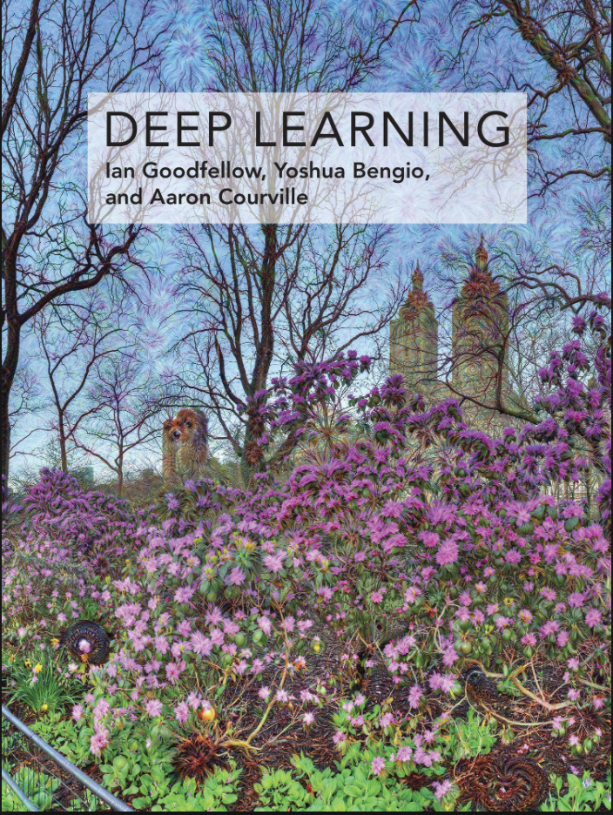
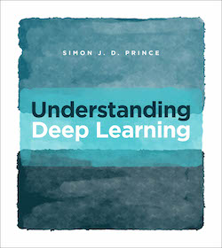
Further resources
Recommended textbooks:
“Deep Learning” (2016) by Goodfellow, Bengio, Courville
“Understanding Deep Learning” (2023) by Prince
Lots of material available online

Slide 4
AI, ML, DL, GenAI

Slide 5
What is artificial intelligence?
Artificial intelligence (AI) is the ability of a computer: to perform tasks commonly associated with intelligent beings; or to build an internal model of the world.

Slide 6
What is machine learning?
Machine learning (ML) is the study of algorithms that learn from examples and experience instead of relying on hard-coded rules and make predictions on new data.

Slide 7
What is deep learning?
Deep learning (DL) is a subfield of ML focusing on learning data representations as successive layers of increasingly meaningful representations.

Slide 8
What is generative AI?
Generative AI (GenAI) a type of AI that can create new content, such as text, images, or music, by learning patterns from existing data.

Slide 9
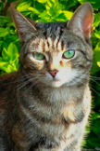
“Traditional” machine learning:
handcrafted features
learned classifier
cat
Deep, “end-to-end” learning:
learned low-level features
learned mid-level features
learned high-level features
learned classifier
cat
Notes:
DL vs divide and conquer
Bitter lesson

Slide 10
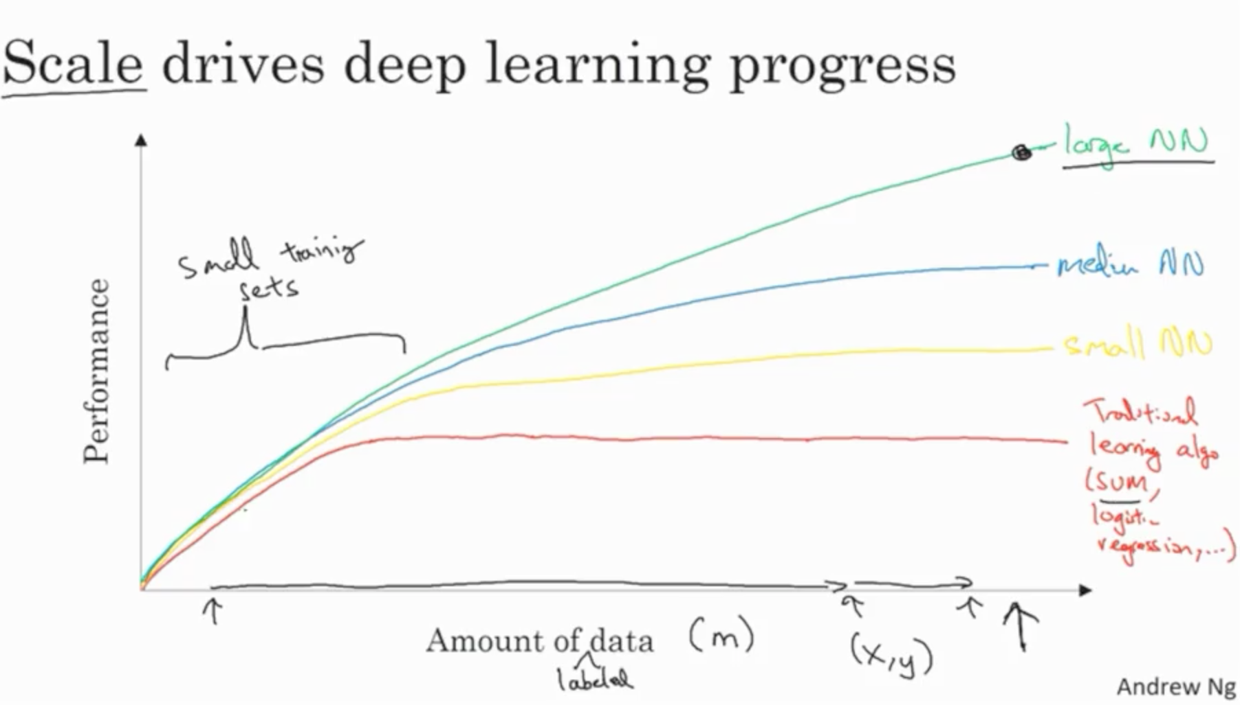

Slide 11

GENERATIVE AI
Original image from https://blogs.nvidia.com/blog/2016/07/29/whats-difference-artificial-intelligence-machine-learning-deep-learning-ai/

Slide 12
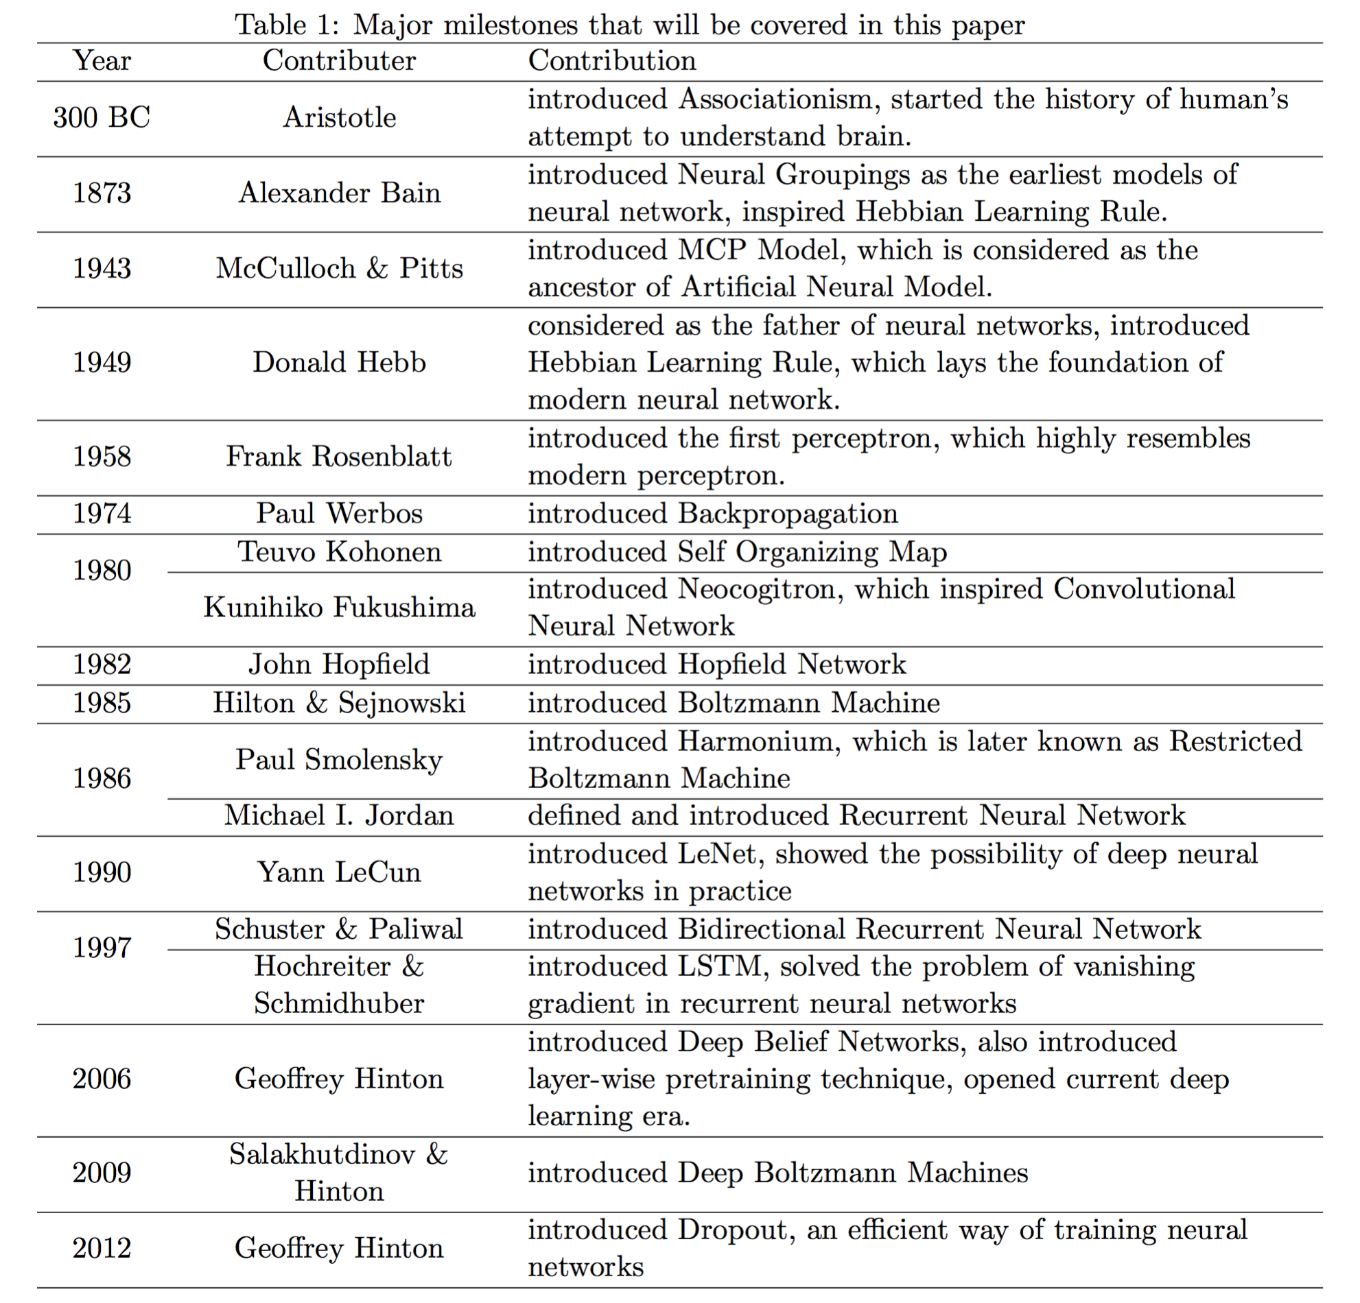
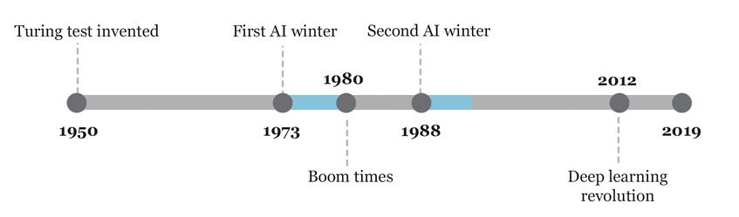
From: Schuchmann, Sebastian. (2019). Analyzing the Prospect of an Approaching AI Winter. 10.13140/RG.2.2.10932.91524.
From: Wang & Raj: On the Origin of Deep Learning (2017)

Slide 13
Fundamentals of machine learning

Slide 14
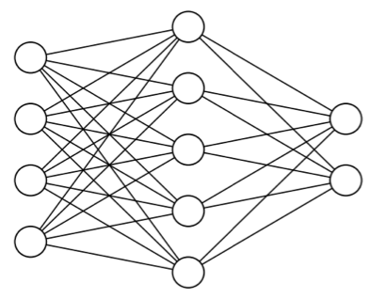
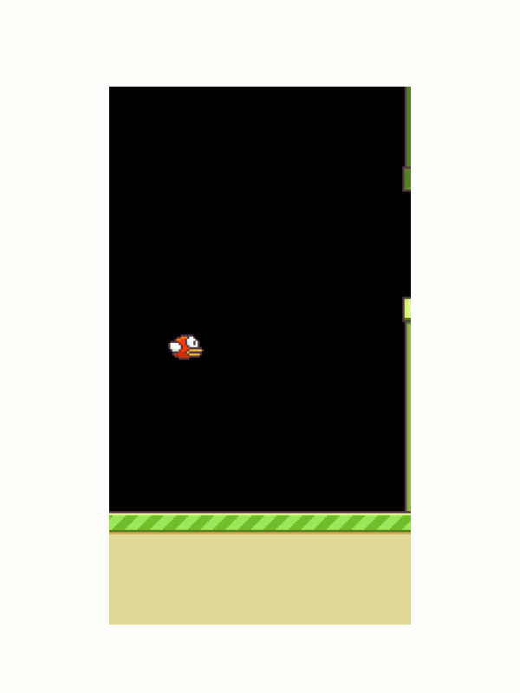
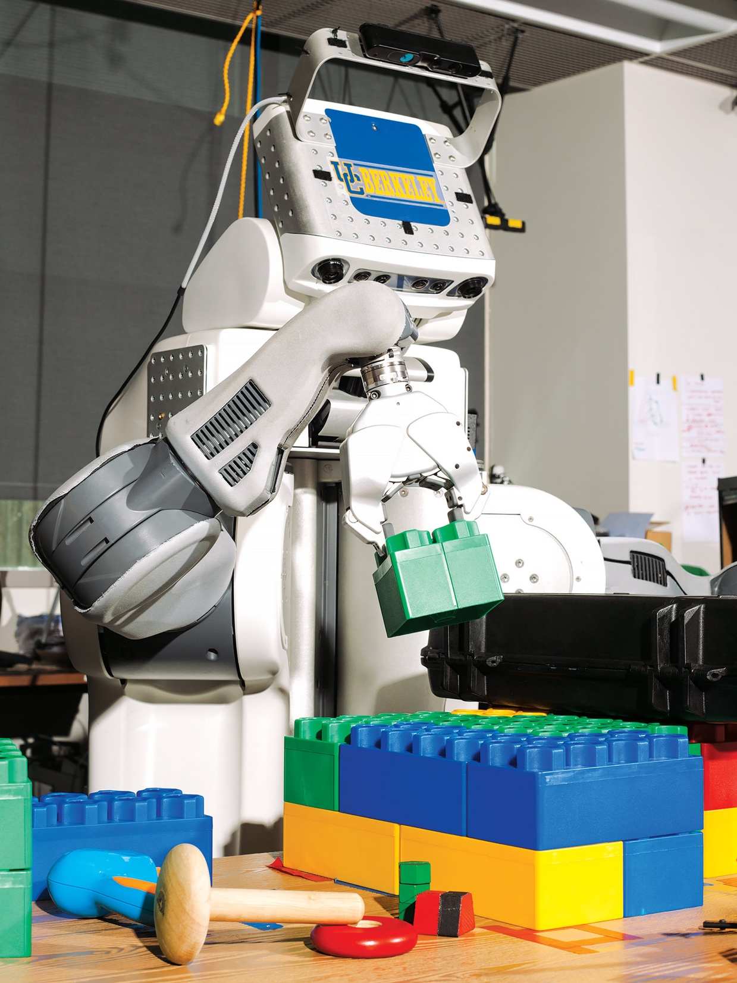
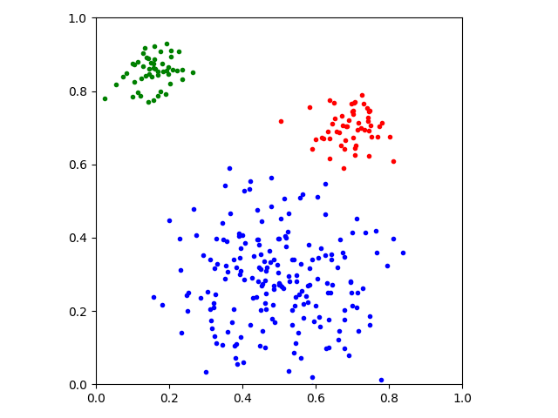
Main types of machine learning
Supervised learning
Unsupervised learning
Reinforcement learning
cat
dog
Animation from: https://yanpanlau.github.io/2016/07/10/FlappyBird-Keras.html

Slide 15
SUPERVISED LEARNING
UNSUPERVISED LEARNING
REINFORCEMENT LEARNING
Original image from https://blogs.nvidia.com/blog/2016/07/29/whats-difference-artificial-intelligence-machine-learning-deep-learning-ai/

Slide 16
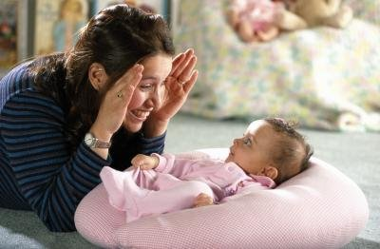
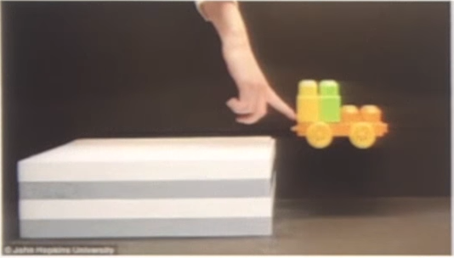
Data
Humans learn by observation and unsupervised learning
model of the world / common sense reasoning
Machine learning needs lots of (labeled) data to compensate
Notes:
How much is difficult to say. Transfer learning. Data augmentation. Simulated data.

Slide 17
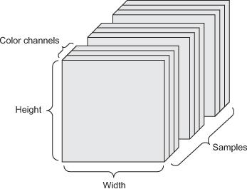
Data
Tensors: generalization of matrices to n dimensions (or rank, order, degree)
1D tensor: vector
2D tensor: matrix
3D, 4D, 5D tensors
numpy.ndarray(), torch.tensor()
Training + validation + test
Minibatches
small sets of input data used at a time

Slide 18
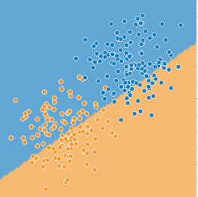
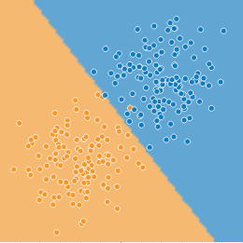
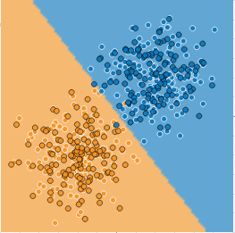
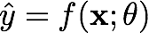
Model – learning/training – inference
http://playground.tensorflow.org/
model output
used ML model
model parameters or weights

Slide 19
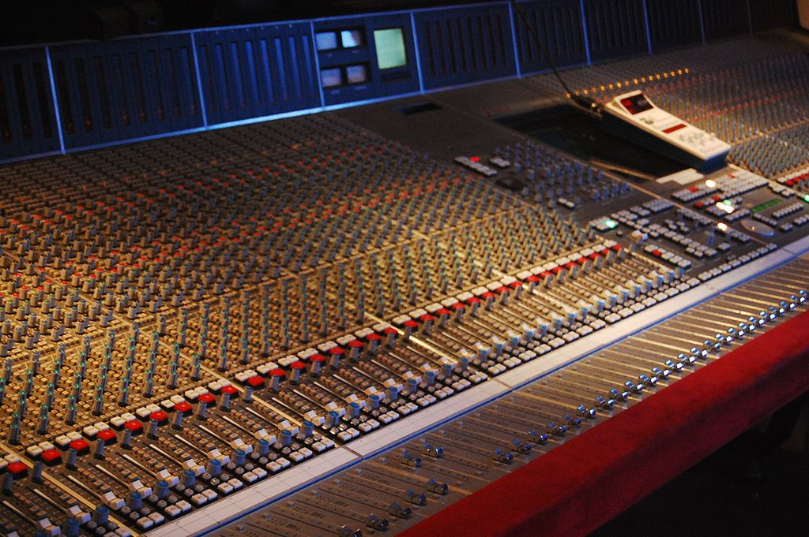
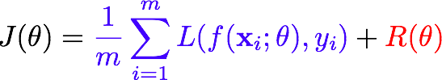
Learning as optimization
Mathematical optimization
Main types: finite-step, iterative, heuristic
By Rebecca Wilson (originally posted to Flickr as Vicariously) [CC BY 2.0], via Wikimedia Commons
Learning as an optimization problem
cost function:
loss
regularization

Slide 20
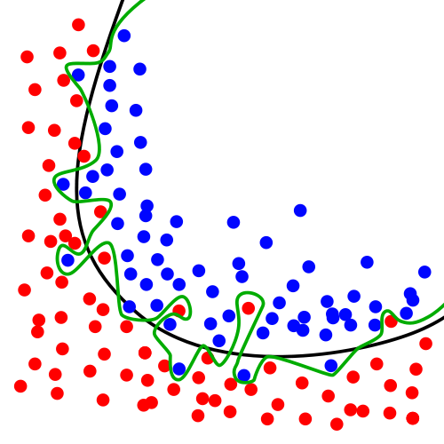
Overfitting, generalization, regularization
Models with lots of parameters can easily overfit to training data
Generalization: quality of a ML model is measured on new, unseen samples
Regularization: any method* to prevent overfitting:
simplicity, sparsity, dropout, early stopping, …
*) other than adding more data
By Chabacano [GFDL or CC BY-SA 4.0], from Wikimedia Commons

Slide 21
Overview of deep learning

Slide 22
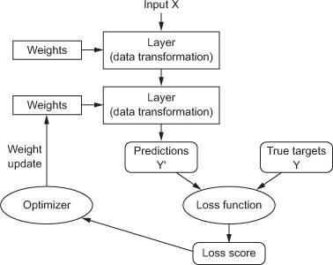
Anatomy of a deep neural network
Layers
Input data and targets
Loss function
Optimizer
Notes:
Art of deep learning

Slide 23
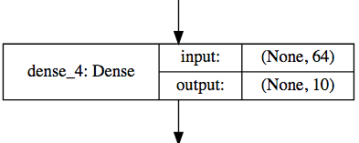
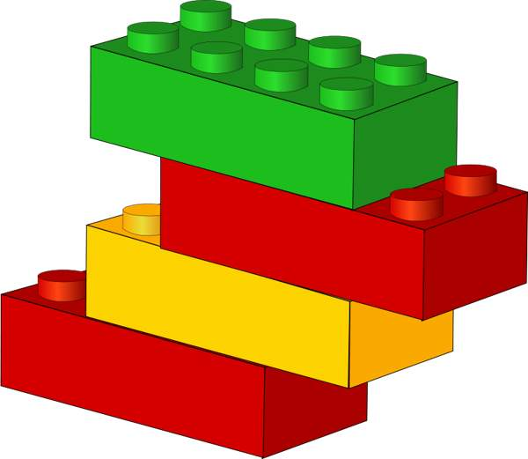
Layers
Data processing modules
Many different kinds exist
densely connected
convolutional
recurrent
pooling, flattening, merging, normalization, etc.
Input: one or more tensors output: one or more tensors
Usually have a state, i.e. weights
learned, initially random
When combined, form a network or a model
Hyperparameters

Slide 24
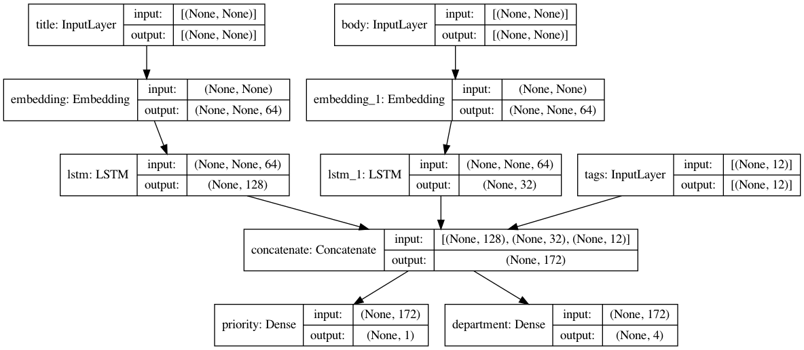
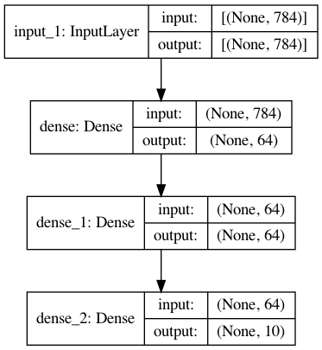
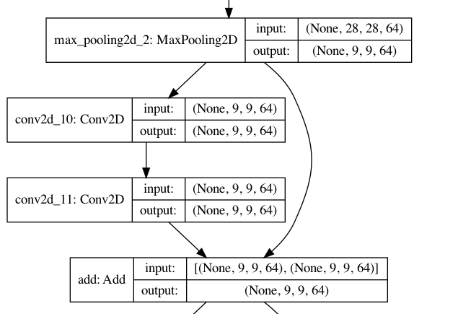
Layers
Images from: https://keras.io/guides/functional_api/

Slide 25
Input data and targets
The network maps the input data X to predictions Y′
During training, the predictions Y′ are compared to true targets Y using the loss function
cat
dog

Slide 26
Loss function
The quantity to be minimized (optimized) during training
the only thing the network cares about
there might also be other metrics you care about
Common tasks have “standard” loss functions:
mean squared error for regression
binary cross-entropy for two-class classification
categorical cross-entropy for multi-class classification
etc.

Slide 27
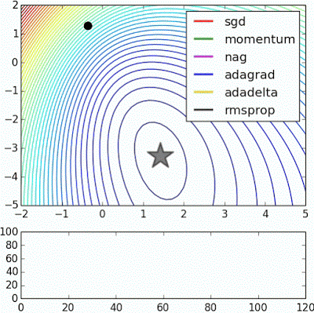
Optimizer
How to update the weights based on the loss function
Learning rate
Stochastic gradient descent, momentum, and their variants
RMSProp and Adam usually good first choices
more info e.g: http://ruder.io/optimizing-gradient-descent/ https://johnchenresearch.github.io/demon/
Animation from: https://imgur.com/s25RsOr
Notes:
RMSProp mentioned in Hinton’s lecture notes

Slide 28
Anatomy of a deep neural network

Slide 29
Deep learning frameworks

Slide 30
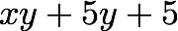
Deep learning frameworks
Actually tools for defining static or dynamic general-purpose computational graphs
Automatic differentiation
Seamless CPU / GPU usage
multi-GPU, distributed
Python/numpy or R interfaces
instead of C, C++, CUDA or HIP
Open source
+
+
✕
✕
x
y
5

Slide 31
Deep learning frameworks
Flax
Flax
Lasagne
Flax
Keras
TF Estimator
torch.nn
Gluon
Jax
Theano
TensorFlow
CNTK
PyTorch
MXNet
Caffe
CUDA, cuDNN ROCm, MIOpen
MKL, MKL-DNN
PyTorch is:
a GPU-based tensor library
an efficient library for neural networks
https://pytorch.org/
GPUs
CPUs

